Slide 1
Start Simple:
Class for rectangle:
What fields?
What methods?
Setting public and private?
Class for bank account?
Fields?
Methods?
Public and private?

Slide 2
public class Rectangle {
private double length;
private double width;
private double area;
private String fillcolor;
Rectangle() {
length = 1.0;
width = 1.0;
setArea();
fillcolor = "white";
}
Rectangle(double l, double w) {
length = l;
width = w;
setArea();
fillcolor = "white";
}
Rectangle(String s) {
length = 1.0;
width = 1.0;
setArea();
fillcolor = s;
}
private void setArea(){
area = length * width;
}
public void setlen(double l) {
length = l;
setArea();
}
public void setwid(double w) {
width = w;
setArea();
}
public String toString(){
String s="Rect: "+(double)((int)(length*100))/100+", "+(double)((int)(width*100))/100+" Area: "+(double)((int)(area*100))/100;
return s;
}
}

Slide 3
public class BankAccount {
private String name;
private double balance;
private double interest;
public BankAccount(String n){
name = n;
balance = 0;
setInterest();
}
public BankAccount(String n, double B) {
name = n;
balance = B;
setInterest();
}
public void setInterest() {
if (balance > 100000.0) {
interest = .25;
}
else if (balance > 10000.0) {
interest = .15;
}
else if (balance > 500.0) {
interest = .075;
}
else {
interest = 0.0;
}
}
public void deposit(double m) {
balance += m;
setInterest();
}
public void withdraw(double m) {
balance -= m;
setInterest();
}
public void calcInterest() {
balance += (balance * interest);
setInterest();
}
public String toString(){
String s = name+": "+(double)((int)(balance*100))/100;
return s;
}
}

Slide 4
2-D Arrays
Make a one-dimensional array of integers:
int[] arr1d = {3,2,4,1,5};
How many elements in the array? (arr1d.length?)
How do you access the element at index 3?
Now make an array that consists of arrays of ints:
int[][] arr2d = {{1,2,3,4},{5,6,7,8},{9,10,11,12}} ;
Or (if we don’t know the values:
int[][] arr2d = new int[3][4];
Can you make an array of arrays of arrays? (a 3-Dimensional array?)

Slide 5
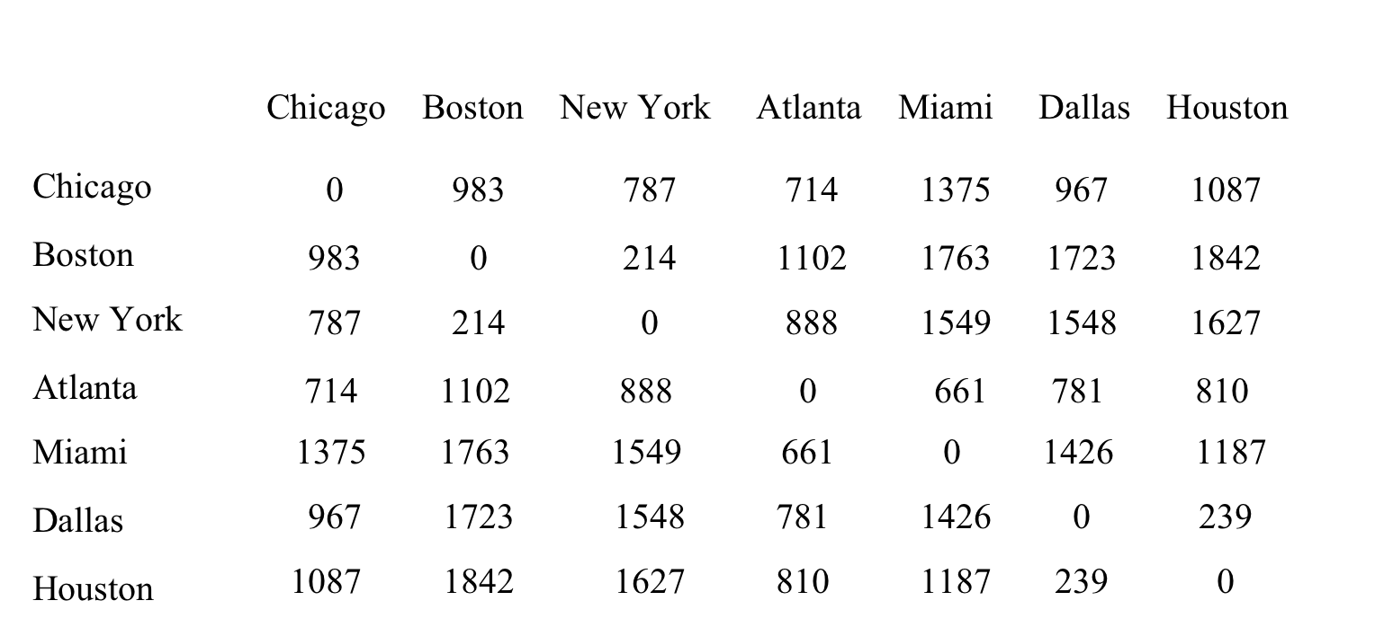
2D Arrays
one-dimensional arrays to model linear collections of elements.
two-dimensional arrays represent a matrix or a table
Example:

Slide 6
Two-dimensional Array Illustration
arr.length?
arr[0].length?
What data type is arr[2] ?

Slide 7
Matrices: Making Arrays of Arrays
1. double[][] mat = new double[5][];
What have I just made?
an array of 5 addresses (that will eventually point to arrays of doubles).
If I can’t do this:
2. double[][] mat = new double [][]?
Why can I do #1?

Slide 8
To create an array of arrays:
You can do:
double[][] mat = {{3.2,4.1,2.5},{7.1,8.2,9.3}};
Or
double[][] mat = new double[3][];
mat[1] = new double[] {3.1,2.4};
Or
double[][] mat = new double[3][];
double[] arr = {7.2,3.1,2.4};
mat[2] = arr;
Or
double[][] mat;
mat = new double[][] {{3.2,4.1,2.5},{7.1,8.2,9.3}};

Slide 9
What is Sudoku?
Every row must have each number between 1 and 9 only once
Every column must have each number between 1 and 9 only once
Every matrix of 9 must have each number between 1 and 9 only once
Can you write a method that checks?
1 for rows
1 for columns
1 for matrices (3x3)
How do we check that each number occurs only once?
Now- one for whole board?

Slide 10
Accessors and Mutators
Accessors (e.g., getField)
public instance methods that access private data
may return different forms of the data
simple convention: getSomeProperty()
Mutators (e.g., setField)
public instance methods that change private data
may change more than one private data element
simple convention: setSomeProperty(x)
Why are these good ideas?

Slide 11
Static Variables and Methods
Static variables and methods are INDEPENDENT of individual objects made from a class
Everything else is specific to the particular object being created from the class.
Static variables (fields) belong to a Class
similar to global variables //avoid global variables!!
Use mostly for constants
easy to create bugs and undefined behavior
Beginners try to make everything STATIC
You don’t want to do that.
Most of the time, we don’t want our fields (or our methods) to be static.

Slide 12
Static methods belong to a Class
Do not have access to object fields
cannot call nonstatic methods (because they use object variables)
often have good uses as simple functions
formulas common to all objects in a Class are often written in a static method
Utility classes – think of the java.util… that we’ve imported – has methods we want to be able to use without having the methods attached to an object.

Slide 13
Versus Instance Variables, and Methods
(variables and methods without "static")
Instance variables belong to a specific instance. Instance methods are invoked by an instance of the class.

Slide 14
Static fields and methods
public class Creature {
private int currentmood = 2;
private String name = "Noname";
private static int creaturecount = 0;
private String[] moods = {"massively depressed","bored stiff","marginally happy", "ecstatic"};
public Creature() {
creaturecount++;
}
public Creature(int mood) {
currentmood = mood;
creaturecount++;
}
public Creature(String Creaturename) {
name = Creaturename;
creaturecount++;
}
public Creature(int mood, String Creaturename) {
currentmood = mood;
name = Creaturename;
creaturecount++;
}
public String getMood() {
return (name +"'s current mood is "+moods[currentmood]);
}
public static String NumberinHerd(){
return ("The current number of creatures is " + creaturecount);
}
}
public class mainclass {
public static void main(String[] args){
Creature Fluffy = new Creature (3);
System.out.println(Creature.NumberinHerd());
System.out.println(Fluffy.getMood());
Creature Bob = new Creature(0, "Bob");
System.out.println(Creature.NumberinHerd());
System.out.println(Bob.getMood());
Creature Killer = new Creature("Killer");
System.out.println(Creature.NumberinHerd());
System.out.println(Killer.getMood());
}
}

Slide 15
The null Value
If a data field of a reference type does not reference any object, the data field holds a special literal value, null. (null reference value)
Example:
Circle circle1 = new Circle(5.0);
Circle circle2 = null;
System.out.println(circle1.getrad()); // what happens here?
System.out.println(circle2.perimeter()); // here?
circle2 = circle1; // what happens here?
System.out.println(circle2.perimeter()); // here?
circle2.setrad(4.2);
System.out.println(circle1.getrad()); //

Slide 16
One more thing on Null references
How do you get rid of an object?
In a game, what if a player dies?
You might want to clear the player object out of memory, but still retain the ability for the rest of the game to detect that the player is “dead”
You’d do this by setting the player object to null
Then you can check:
if (players[x] != null)

Slide 17
Student Class
public class StudentInfo {
private String first;
private String last;
private String[] schedule;
public StudentInfo(String f, String l, String[] sched) {
first = f;
last=l;
schedule = sched;
}
public String toString() {
String str = "";
str += first + "\t"+ last + "\n";
for (int i = 0; i < schedule.length; i++) {
str += schedule[i]+ "\t";
}
return(str);
}
}
Note the \t and \n - “escape sequences”
\t adds a tab
\n adds a new line (makes the printout go to the next line.

Slide 18
Alternative Student Class
Instead of making the schedule array be an array of Strings, make it be an array of objects of type Classes.
The Classes type has two fields: Dept and coursenum:
public class Course {
public String dept;
public int coursenum;
public Course(String d, int cn) {
dept = d;
coursenum = cn;
}
}
Can we now rewrite the student class by creating an array of Classes objects?

Slide 19
public class Student {
private String first;
private String last;
private Course[] schedule;
public StudentInfo(String f, String l) {
first = f;
last=l;
schedule = getSchedule();
}
public Course[] getSchedule() {
int num = Integer.parseInt(JOptionPane.showInputDialog("How many courses are you taking?"));
Course[] arr = new Course[num];
for (int i = 0; i < num; i++) {
String dept = JOptionPane.showInputDialog("Department?");
int coursenum = Integer.parseInt(JOptionPane.showInputDialog("Course Number?"));
arr[i] = new Course(dept, coursenum);
}
return(arr);
}
}
And now toString?
public class Course {
public String dept;
public int coursenum;
public Course(String d, int cn) {
dept = d;
coursenum = cn;
}
}
//why are the fields public? Should I have done something different here?

Slide 20
My toString()
public String toString() {
String str = "";
str += first + "\t"+ last + "\n";
for (int i = 0; i < schedule.length; i++) {
str += schedule[i].dept + " " + schedule[i].coursenum + "\n";
}
return(str);
}
What type is schedule an array of?
What fields does that type have?

